Slide 1
CS 4504 Parallel and Distributed Computing Process
Kun Suo
Computer Science, Kennesaw State University
https://kevinsuo.github.io/

Slide 2
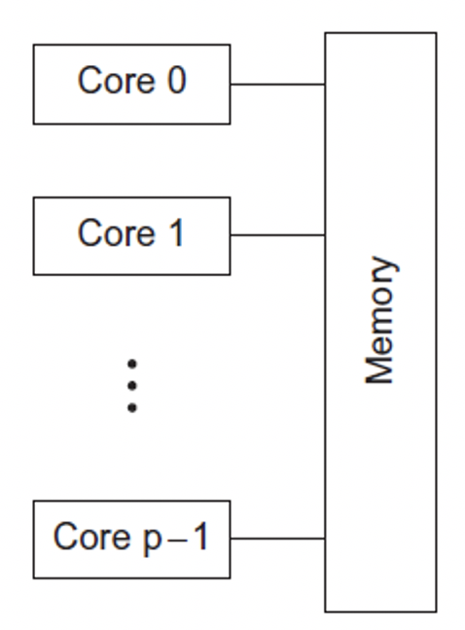

Test
What is Shared-memory
The cores can share access to the computer’s memory.
Coordinate the cores by having them examine and update shared memory locations.

Slide 3
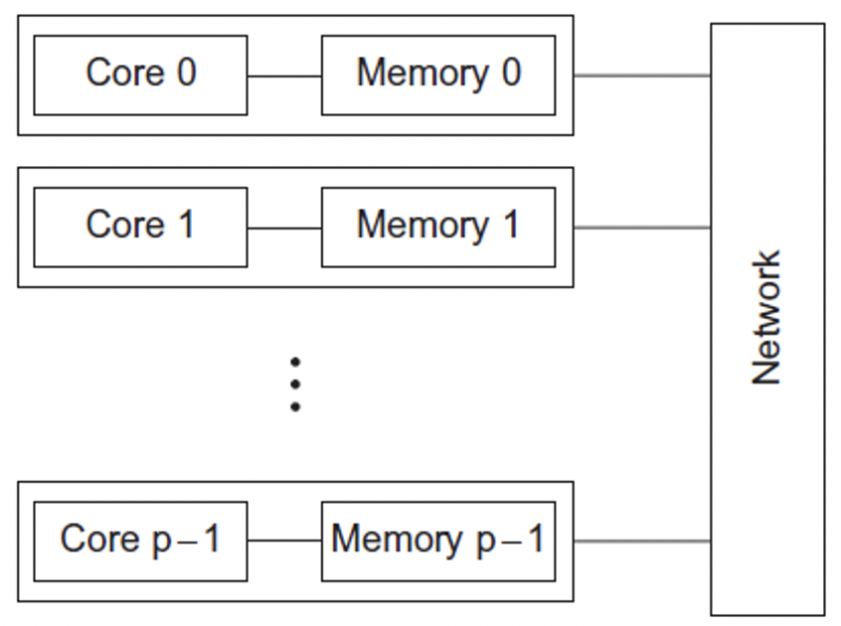
Test
What is Distributed-memory
Each core has its own, private memory.
The cores must communicate explicitly by sending messages across a network.

Slide 4
Test
Concurrent computing – a program is one in which multiple tasks can be in progress at any instant.
Parallel computing – a program is one in which multiple tasks cooperate closely to solve a problem
Distributed computing – a program may need to cooperate with other programs to solve a problem.

Slide 5
Test
Concurrent computing – a program is one in which multiple tasks can be in progress at any instant.
Parallel computing – a program is one in which multiple tasks cooperate closely to solve a problem
Distributed computing – a program may need to cooperate with other programs to solve a problem.

Slide 6
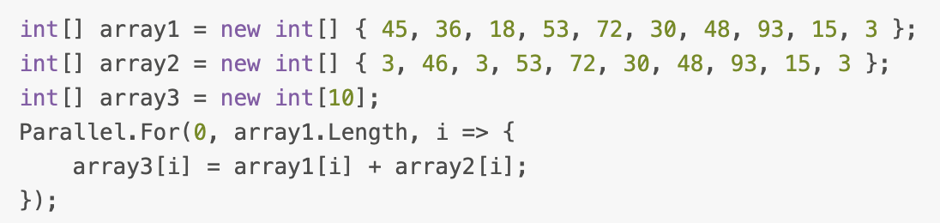
Test
Array A = Array B + Array C
Data operation in parallel (data parallelism) is relatively simple and concise, it does not require the programmer to care about how the parallel machine performs the operation
array3= {48,82,21,106,144,60,96,186,30,6}；

Slide 7
Test
You have a large data set, and you want to know the minimum, maximum, and average values of the data set
How to design process this work using data parallelism or task parallelism?

Slide 8
Test: data parallelism
minimum, maximum, average
minimum, maximum, average
minimum, maximum, average
minimum, maximum, average

Slide 9
Test: task parallelism
minimum
maximum
average

Slide 10
Test
Suppose we want to sort 8GB of data, and our machine's memory can hold so much data at once.
Theoretically speaking, the sorting problem is already difficult to optimize from the algorithm level.
The optimal complexity is O(nlogn). Mergesort = Quicksort = Heapsort = …
How to run this problem in parallel?

Slide 11
Test: merge sort
Data + task parallelism
8GB data is divided into 16 small data sets, each set contains 500MB of data.
We used 16 threads to sort these 16 500MB data sets in parallel. After the 16 small sets are sorted separately, we merge the 16 ordered sets.

Slide 12
Test: quick sort
Data + task parallelism
Scan the data to find the range of the data. We created 16 small intervals from small to large.
We divide 8GB of data into corresponding intervals. For these 16 cells, we start 16 threads to sort in parallel.
After the execution of all 16 threads, the data obtained is ordered data.

Slide 13
Test: quick sort
Data + task parallelism
Unsorted inside
Data 1
Data 3
Data k
<
Data 16
<
<

Slide 14
Outline
What is process?
Process vs Program
Linux Process Control Block
Process related System calls
Fork
Exec
Wait
Process on Distributed OSes

Slide 15
Process
Definition
An instance of a program running on a computer
An abstraction that supports running programs - -> cpu virtualization
An execution stream in the context of a particular process state - -> dynamic unit
A sequential stream of execution in its own address space - -> execution code line by line

Slide 16
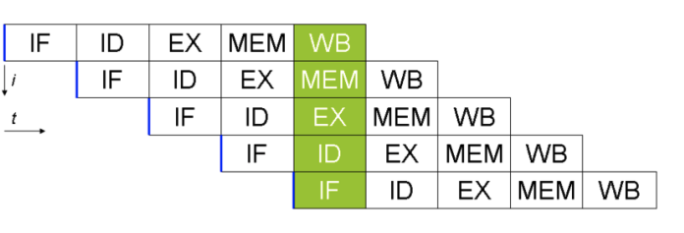
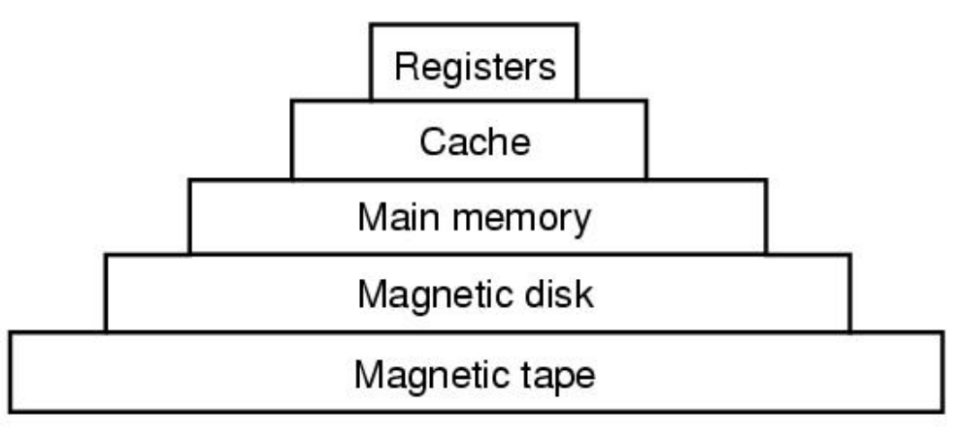
Process
Two parts of a process
Sequential execution of instructions
Process state
registers: PC (program counter), SP (stack pointer),…
Memory: address space, code, data, stack, heap …
I/O status: open files …

Slide 17
Program vs. Process
Program != Process
Program = static code + data
Process = dynamic instantiation of code + data + files …
No 1:1 mapping
Program : process = 1:N
A program can invoke many processes

Slide 18
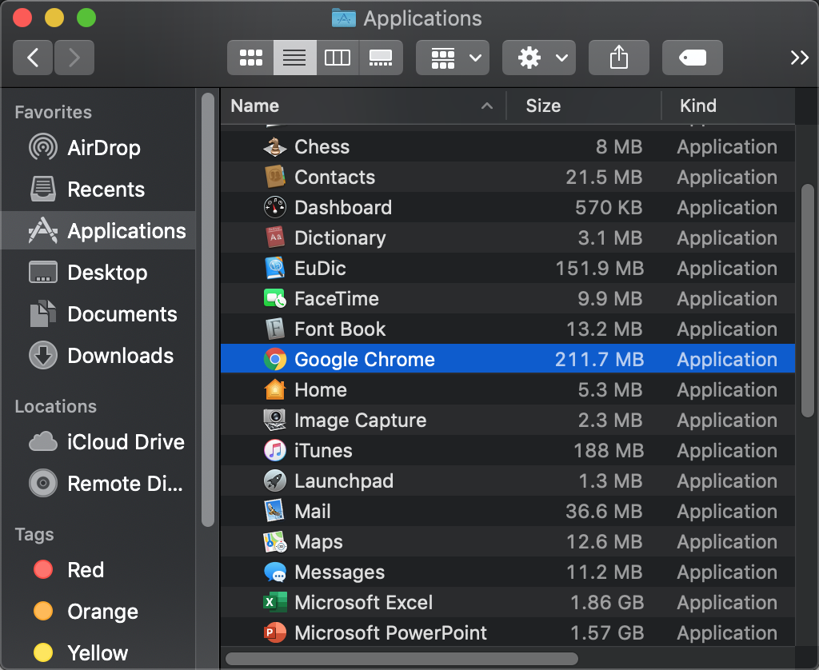
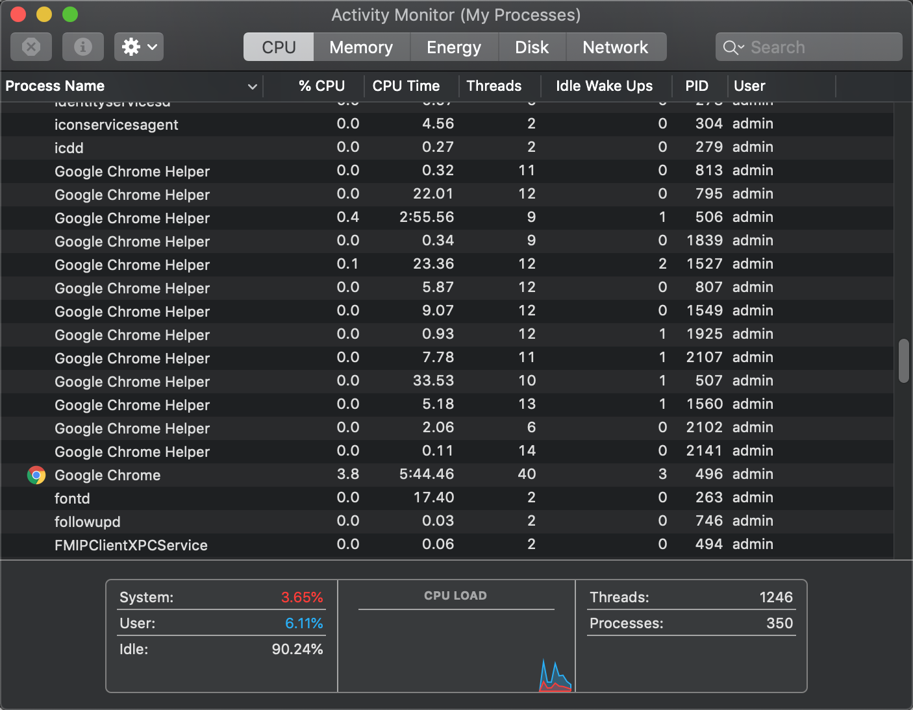
Program vs. Process
Process:
The running instantiation of a program, stored in RAM
Program:
An executable file in long-term storage
One-to-many relationship between program and processes

Slide 19
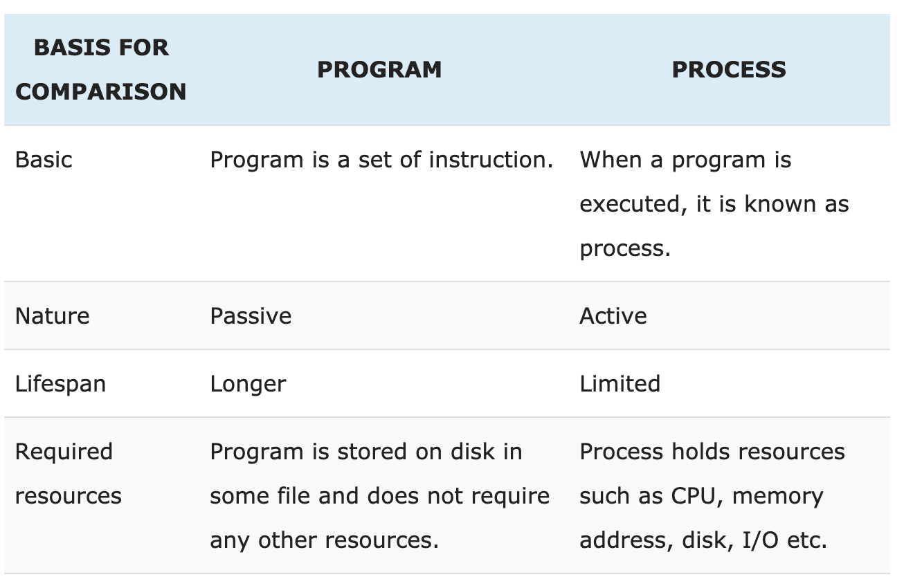
Program vs. Process
https://techdifferences.com/difference-between-program-and-process.html

Slide 20
Process Descriptor
Process
Driving license
ID
Name
Address
Birth
Time
…
Process control block (PCB)
State
Identifiers
Scheduling info
File system
Virtual memory
Process specific context
…

Slide 21
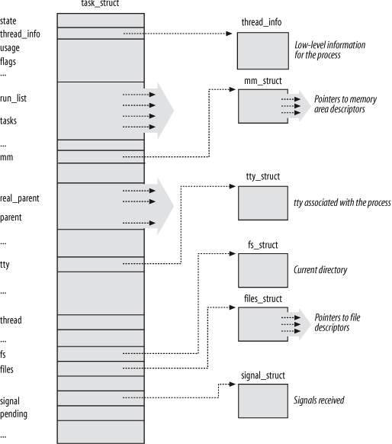
Process in Linux
https://elixir.bootlin.com/linux/v5.4/source/include/linux/sched.h#L624
Process control block (PCB)
State
Identifiers
Scheduling info
File system
Virtual memory
Process specific context
…

Slide 22
Process in Linux
Process control block (PCB)
State
Identifiers
Scheduling info
File system
Virtual memory
Process specific context
…

Slide 23
Linux PCB (5-state model to describe lifecycle of one process)
State
TASK_RUNNING
Running, ready
TASK_INTERRUPTABLE
Blocked
EXIT_ZOMBIE
Terminated by not deallocated
EXIT_DEAD
Completely terminated
new
admit
interrupt
exit
terminated
ready
running
I/O or event completion
scheduler dispatch
I/O or event wait
Blocked

Slide 24
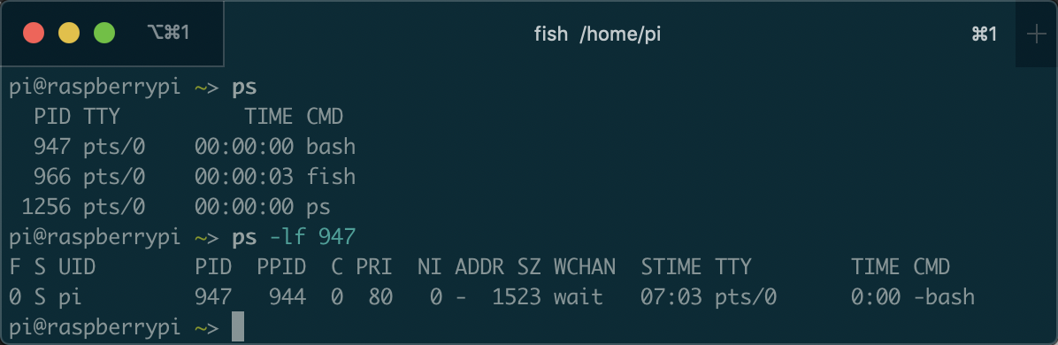
$ ps -lf : process information
Bash is a UNIX OS shell program
The state of the process
R ：The process is running
S ：The process is sleeping/idle
T ：The process is terminated
Z ：The process is in zombie state

Slide 25
$ ps -lf : process information
https://github.com/kevinsuo/CS7172/blob/master/sleep.c
https://github.com/kevinsuo/CS7172/blob/master/loop.c
Download: wget Raw-file-URL
Compile: gcc [file-name].c –o [file-name].o
Run: ./[file-name].o
What is the state of the process?

Slide 26
Process in Linux
Process control block (PCB)
State
Identifiers
Scheduling info
File system
Virtual memory
Process specific context
…

Slide 27
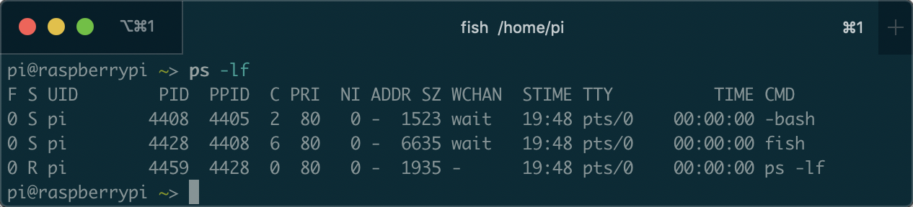
Linux Process Control Block (cont’)
Identifiers
pid: ID of the process
ID for this process
Parent process ID

Slide 28
Process in Linux
Process control block (PCB)
State
Identifiers
Scheduling info
File system
Virtual memory
Process specific context
…

Slide 29

Linux Process Control Block (cont’)
Scheduling information
prio, static_prio, normal_prio
rt_priority
sched_class

Slide 30
Linux Process Control Block (cont’)
Scheduling information
prio, static_prio, normal_prio
P₁
P₂
P₃
P₄
P₁
P₂
P₃
P₄
Static priority: P1 > P2 = P3 = P4, P1 can execute whenever it needs;
Normal priority: P1 = P2 = P3 = P4, P1 execute depending on the scheduling algorithm;
Prio: dynamic priority, will change over the time

Slide 31
Linux Process Control Block (cont’)
Scheduling information
rt_priority
P₁
P₂
P₃
P₄
P₁
P₂
P₃
P₄
Rt_priority process is always higher than other priority of processes and will be scheduled immediately when it needs

Slide 32
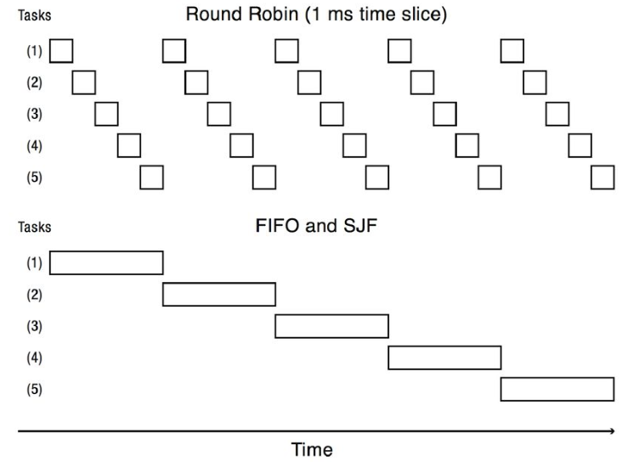
Linux Process Control Block (cont’)
Scheduling information
sched_class: different scheduling policy implementations, e.g., FIFO, SJF, RR…
Task->sched_class->pick_next_task(runqueue)
pick_next_task of RR:
pick based on time cycle
pick_next_task of FIFO:
pick based on order

Slide 33
$ ps -lf : process information
Bash is a UNIX OS shell program
How many cpus it consumes
Nice value: default is 0, could be modified to adjust the priority
Process priority value

Slide 34
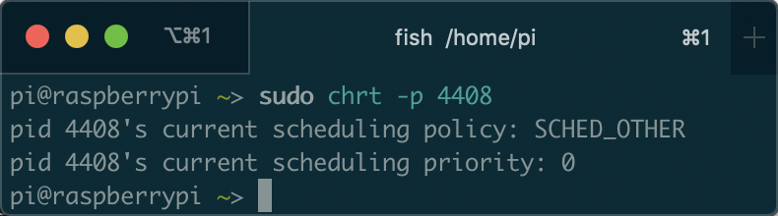
$ chrt: process scheduling info
scheduling policy
scheduling priority
SCHED_OTHER min/max priority : 0/0 SCHED_FIFO min/max priority : 1/99 SCHED_RR min/max priority : 1/99 SCHED_BATCH min/max priority : 0/0

Slide 35
Process in Linux
Process control block (PCB)
State
Identifiers
Scheduling info
File system
Virtual memory
Process specific context
…

Slide 36
Linux Process Control Block (cont’)
Files
fs_struct
file system information: root directory, current directory
https://elixir.bootlin.com/linux/v4.2/source/include/linux/sched.h#L1525

Slide 37
Linux Process Control Block (cont’)
Files
files_struct
Information on opened files
https://elixir.bootlin.com/linux/v4.2/source/include/linux/sched.h#L1528

Slide 38
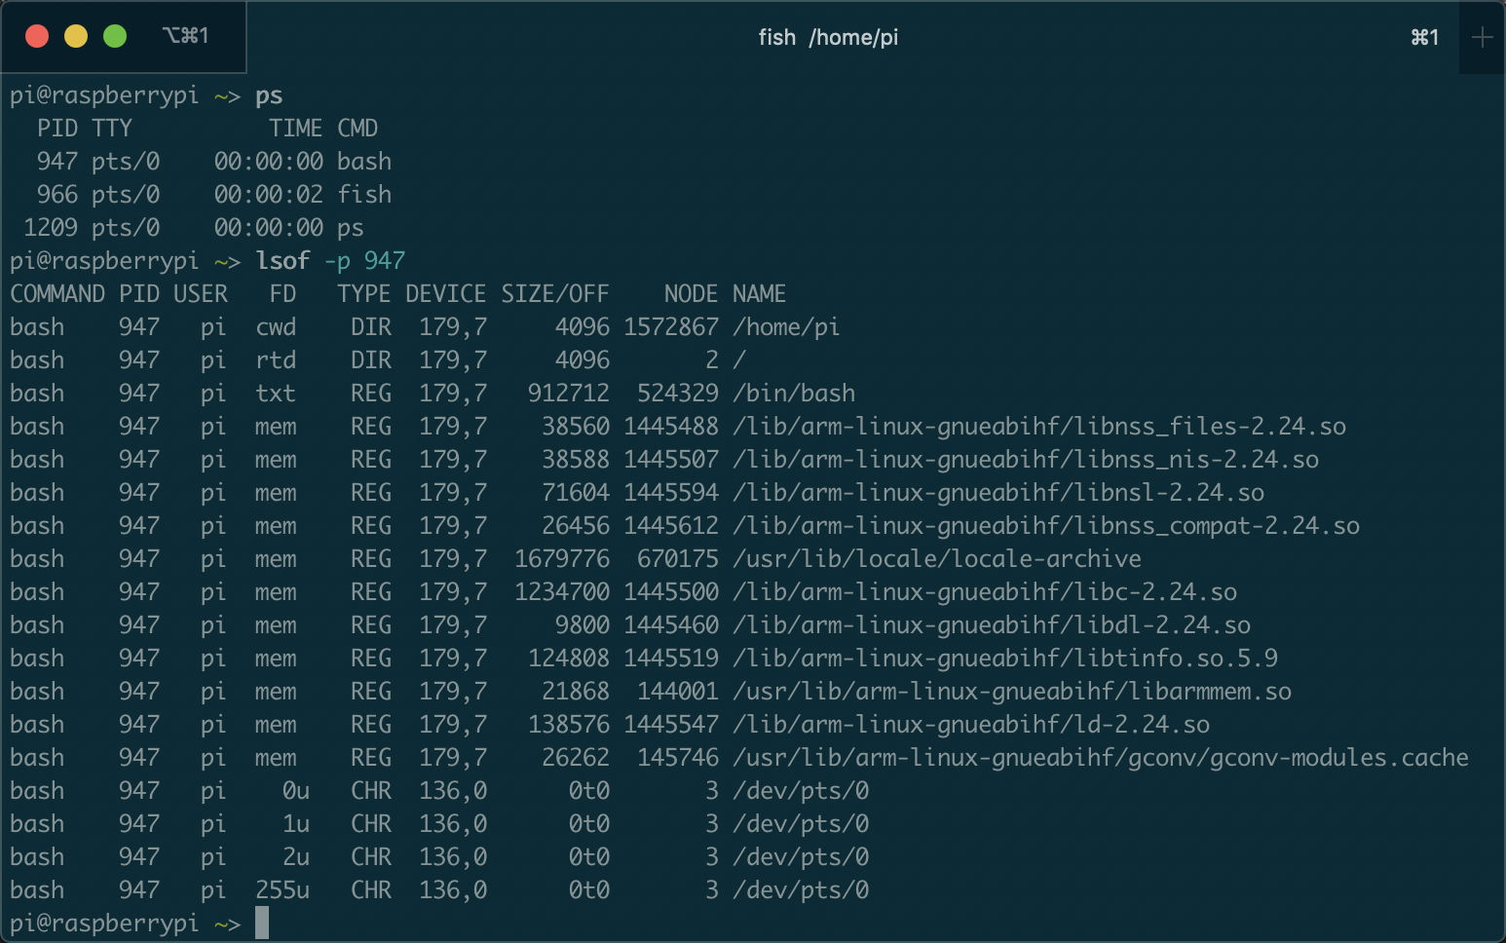
$lsof: list all open files
All files opened by bash
File descriptor, size, name, location, …

Slide 39
Process in Linux
Process control block (PCB)
State
Identifiers
Scheduling info
File system
Virtual memory
Process specific context
…

Slide 40
Linux Process Control Block (cont’)
Virtual memory
mm_struct: describes the content of a process’s virtual memory
The pointer to the page table and the virtual memory areas

Slide 41
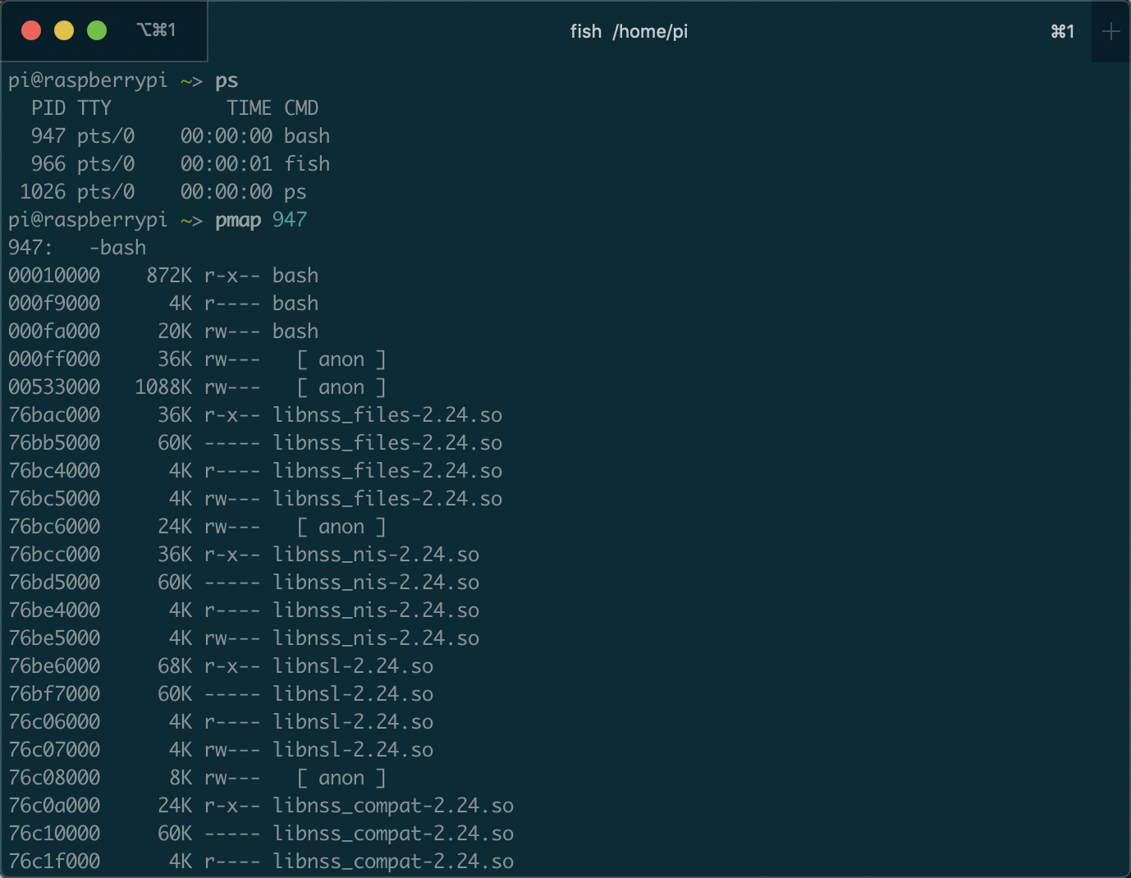
$pmap: memory mapping
All memory accessed by bash
Memory address
size
memory used by process bash
Read/write/execution permission
Lib/execution file

Slide 42
$pmap: memory mapping
Memory address
Code loaded by bash
Constant/static variable loaded by bash
size
Data loaded by bash
Read/write/execution permission
Lib/execution file

Slide 43
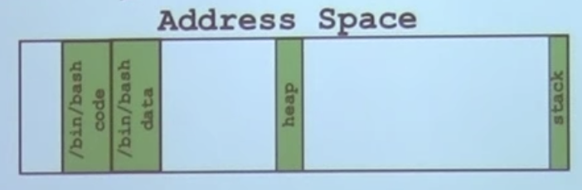
$pmap: memory mapping
Bash in memory
Memory address
size
Read/write/execution permission
Lib/execution file

Slide 44
Outline
What is process?
Process vs Program
Linux Process Control Block
Process related System calls
Fork
Exec
Wait
Process on Distributed OSes

Slide 45
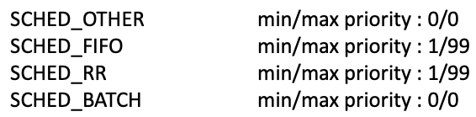
Test: create a process and show the following information of it
https://github.com/kevinsuo/CS7172/blob/master/sleep.c
Download: wget Raw-file-URL
Compile: gcc [file-name].c –o [file-name].o
Run: ./[file-name].o
What is the process ID?
What is the process state?
What is the scheduling policy for the process?
Show all files the process it is using.
Show all memory the process it is using.
Notes:
https://github.com/kevinsuo/CS7172/blob/master/sleep.c

Slide 46
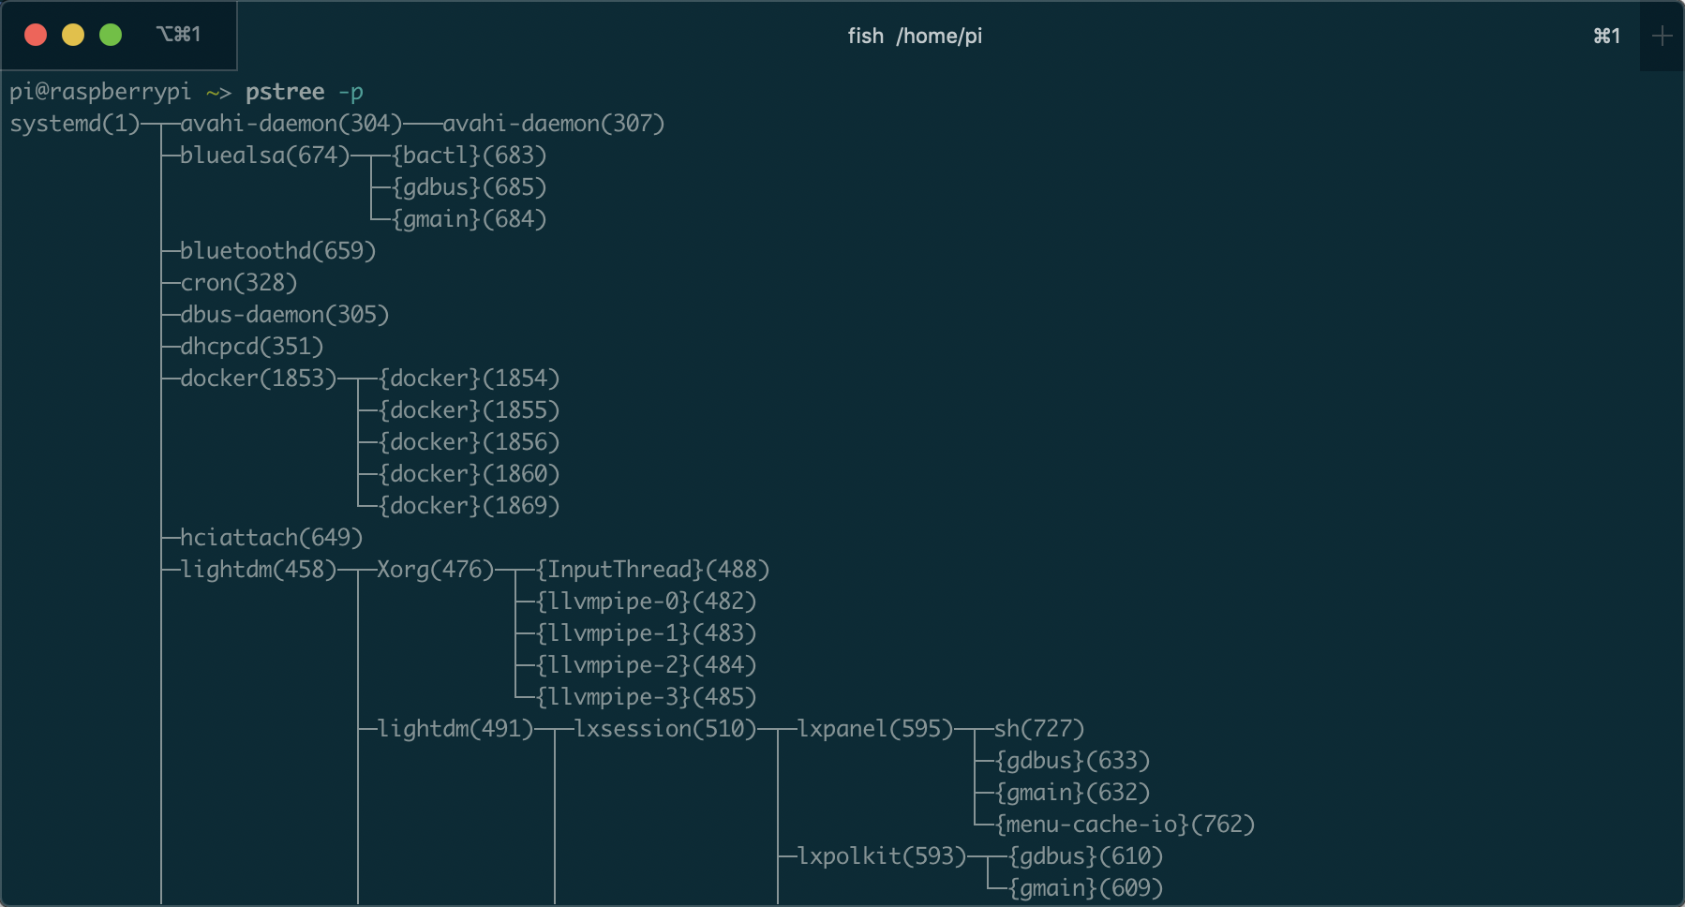
Where do processes come from?
Process creation always uses fork() system call

Slide 47
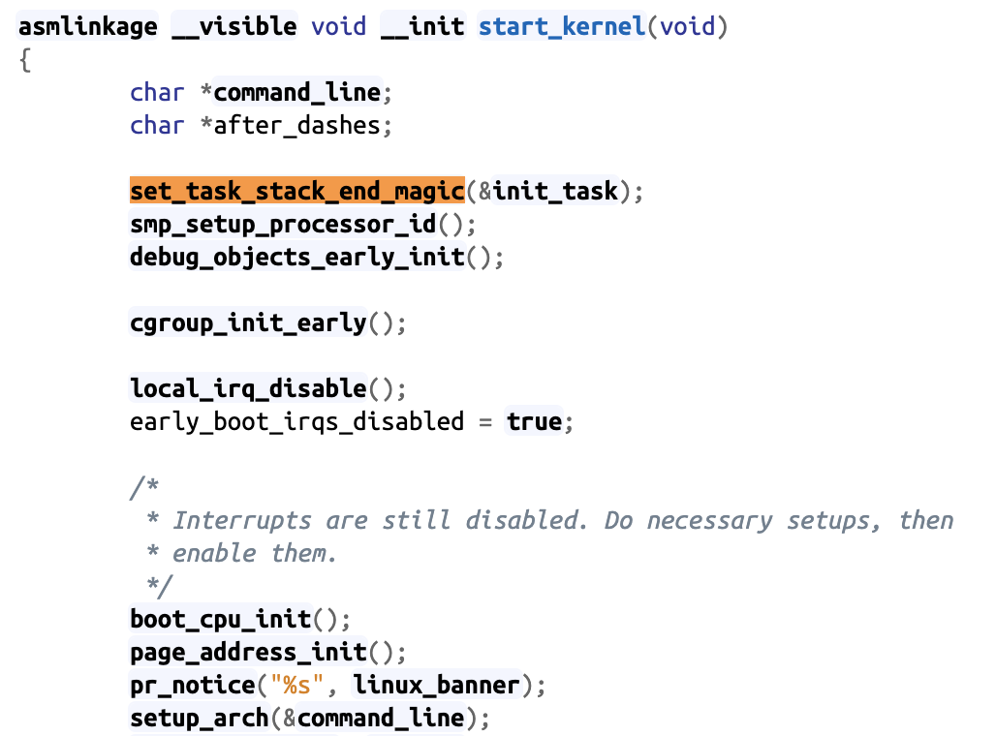
Where do processes come from? First process in the kernel
The start of linux kernel begins from start_kernel() function, it is equal to the main function of kernel
set_task_stack_end_magic() creates the first process in the OS
The first process is the only one which is not created by fork function
https://elixir.bootlin.com/linux/v5.4/source/init/main.c#L580

Slide 48
Fork() system call
Process creation always uses fork() system call
When?
User runs a program at command line
$./test.o
OS creates a process to provide a service
Timer, networking, load-balance, daemon, etc.
One process starts another process
Parents and child process

Slide 49
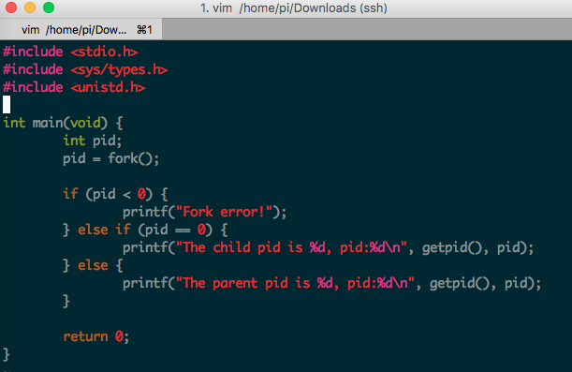
Fork() system call
https://github.com/kevinsuo/CS7172/blob/master/fork.c
Notes:
#include <stdio.h>
#include <sys/types.h>
#include <unistd.h>
int main(void) {
int pid;
pid = fork();
if (pid < 0) {
printf("Fork error!");
} else if (pid == 0) {
printf("The child pid is %d, pid:%d\n", getpid(), pid);
} else {
printf("The parent pid is %d, pid:%d\n", getpid(), pid);
}
return 0;
}

Slide 50
Fork() system call
fork() is called once. But it returns twice!!
Once in the parent (return child id > 0)
Once in the child (return 0)

Slide 51
Fork() system call
https://github.com/kevinsuo/CS7172/blob/master/fork.c
fork() is called once. But it returns twice!!
Notes:
#include <stdio.h>
#include <sys/types.h>
#include <unistd.h>
int main(void) {
int pid;
pid = fork();
if (pid < 0) {
printf("Fork error!");
} else if (pid == 0) {
printf("The child pid is %d, pid:%d\n", getpid(), pid);
} else {
printf("The parent pid is %d, pid:%d\n", getpid(), pid);
}
return 0;
}

Slide 52
Fork() system call
fork() is the UNIX system call that creates a new process.
fork() creates a new process that is a copy of the calling process.
After fork () we refer to the caller as the parent and the newly-created process as the child. They have a special relationship and special responsibilities.

Slide 53
Parent process and child process
When a parent process uses fork() to create a child process, the two processes have
the same program text.
but separate copies of the data, stack, and heap segments.

Slide 54
Parent process and child process
The child’s stack, data, and heap segments are initially exact duplicates of the corresponding parts the parent’s memory.
After the fork(), each process can modify the variables in its own data, stack, and heap segments without affecting the other process.

Slide 55
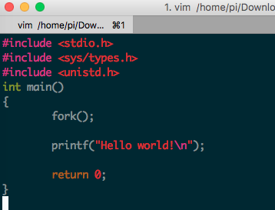
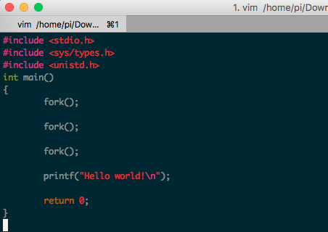
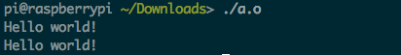
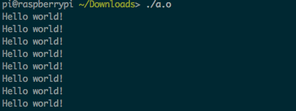
Fork() example
Parent
Child

Slide 56
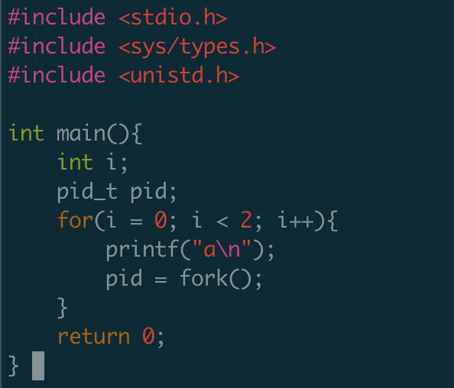
Fork() example
How many a it will output?

Slide 57
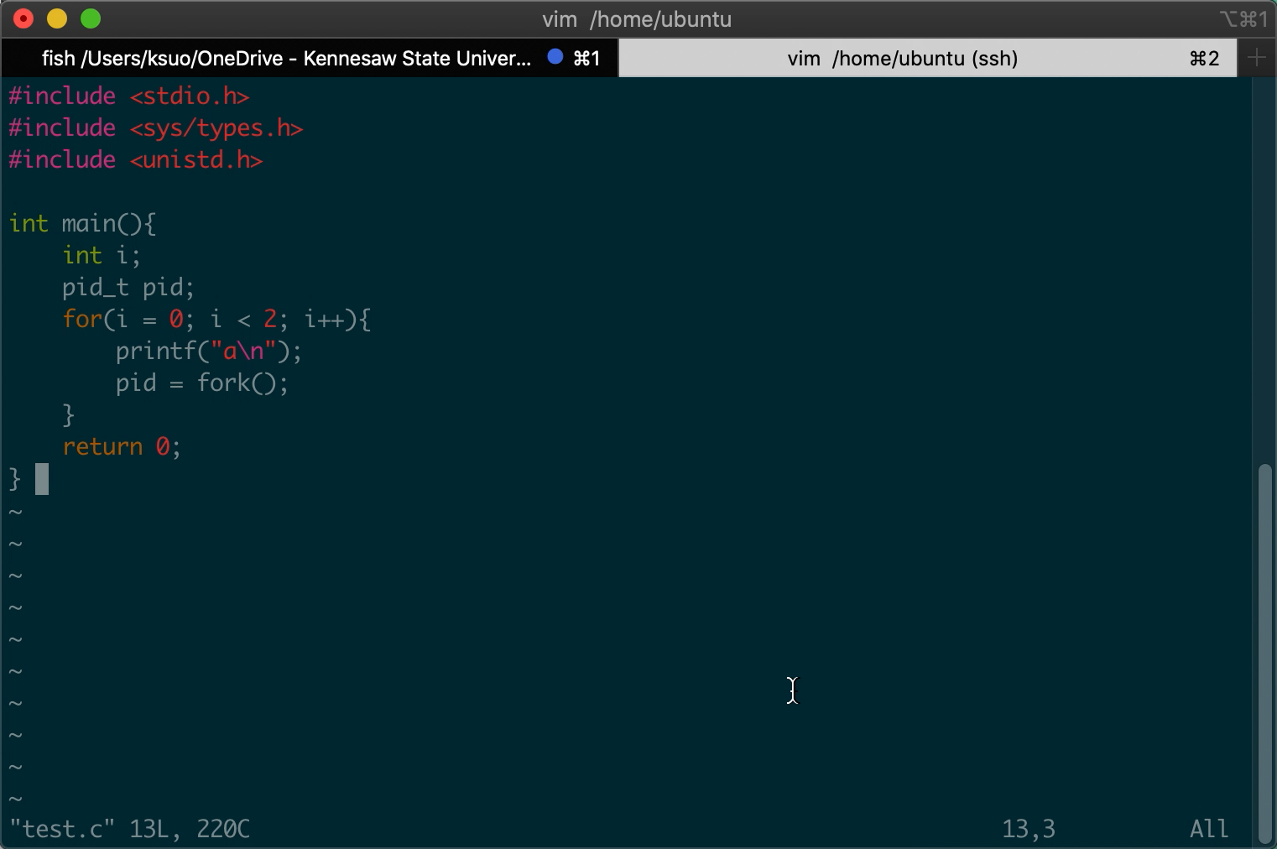
Fork() example

Slide 58
Fork() example
How many a it will output?
Main: a
Create a process named 111
i=0
Main: a
Create a process named 222
111: a
Create a process named 333
i=1

Slide 59
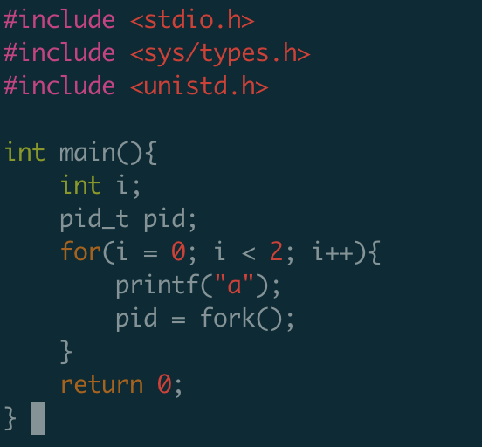
Fork() example
How many a it will output?

Slide 60
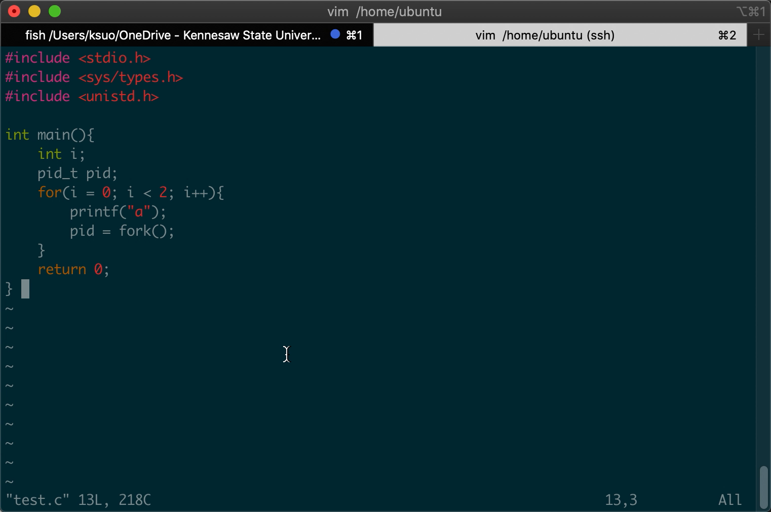
Fork() example
How many a it will output?

Slide 61
Fork() example
Printf (without /n) will not flush the buffer until the program finished
main
Main: a
Create a process named 111
i=0
Main: a
Create a process named 222
111: a
Create a process named 333
i=1

Slide 62
Fork() example
Printf (without /n) will not flush the buffer until the program finished
main
111
Main: a
Create a process named 111
i=0
Main: a
Create a process named 222
111: a
Create a process named 333
i=1

Slide 63
Fork() example
Printf (without /n) will not flush the buffer until the program finished
main
111
Main: a
Create a process named 111
i=0
222
Main: a
Create a process named 222
111: a
Create a process named 333
i=1

Slide 64
Fork() example
Printf (without /n) will not flush the buffer until the program finished
main
111
Main: a
Create a process named 111
i=0
222
Main: a
Create a process named 222
111: a
Create a process named 333
i=1
333

Slide 65
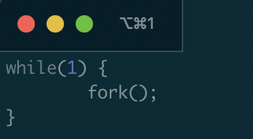
A fork() bomb
What does this code do?
Agent smith

Slide 66
Test
Assume the following code is compiled and run on a modern Linux machine (assume any irrelevant details have been omitted):
main() {
int i = 0;
int rc = fork();
i++;
if (rc == 0) {
rc = fork();
i++;
} else {
i++;
}
printf(“Hello!\n”);
printf(“i is %d\n”, i);
}
Assuming fork() never fails, how many times will the message “Hello!\n” be displayed? And explain your answer.
a) 2
b) 3
c) 4
d) 6
e) None of the above

Slide 67
Test
Assume the following code is compiled and run on a modern Linux machine (assume any irrelevant details have been omitted):
main() {
int i = 0;
int rc = fork();
i++;
if (rc == 0) {
rc = fork();
i++;
} else {
i++;
}
printf(“Hello!\n”);
printf(“i is %d\n”, i);
}
Assuming fork() never fails, how many times will the message “Hello!\n” be displayed? And explain your answer.
a) 2
b) 3
c) 4
d) 6
e) None of the above

Slide 68
Test
Assume the following code is compiled and run on a modern Linux machine (assume any irrelevant details have been omitted):
main() {
int a = 0;
int rc = fork();
a++;
if (rc == 0) {
rc = fork();
a++;
} else {
a++;
}
printf(“Hello!\n”);
printf(“a is %d\n”, a);
}
What will be the largest value of “a” displayed by the program? And explain your answer.
a) Due to race conditions, “a” may have different values on different runs of the program.
b) 2
c) 3
d) 5
e) None of the above

Slide 69
Test
Separate copies of a in each process:
Parent process: a = 0; a++; a++; → a=2.
Child process: a=0 (after fork()); a++; a++; → a=2.
Grandchild: a=1 (after fork()); a++; → a =2.
(2.1) For the next two questions, assume the following code is compiled and run on a modern Linux machine (assume any irrelevant details have been omitted):
main() {
int a = 0;
int rc = fork();
a++;
if (rc == 0) {
rc = fork();
a++;
} else {
a++;
}
printf(“Hello!\n”);
printf(“a is %d\n”, a);
}
a
0

Slide 70
Test
Separate copies of a in each process:
Parent process: a = 0; a++; a++; → a=2.
Child process: a=0 (after fork()); a++; a++; → a=2.
Grandchild: a=1 (after fork()); a++; → a =2.
(2.1) For the next two questions, assume the following code is compiled and run on a modern Linux machine (assume any irrelevant details have been omitted):
main() {
int a = 0;
int rc = fork();
a++;
if (rc == 0) {
rc = fork();
a++;
} else {
a++;
}
printf(“Hello!\n”);
printf(“a is %d\n”, a);
}
a
a
0
0

Slide 71
Test
Separate copies of a in each process:
Parent process: a = 0; a++; a++; → a=2.
Child process: a=0 (after fork()); a++; a++; → a=2.
Grandchild: a=1 (after fork()); a++; → a =2.
(2.1) For the next two questions, assume the following code is compiled and run on a modern Linux machine (assume any irrelevant details have been omitted):
main() {
int a = 0;
int rc = fork();
a++;
if (rc == 0) {
rc = fork();
a++;
} else {
a++;
}
printf(“Hello!\n”);
printf(“a is %d\n”, a);
}
a
a
1
1

Slide 72
Test
Separate copies of a in each process:
Parent process: a = 0; a++; a++; → a=2.
Child process: a=0 (after fork()); a++; a++; → a=2.
Grandchild: a=1 (after fork()); a++; → a =2.
(2.1) For the next two questions, assume the following code is compiled and run on a modern Linux machine (assume any irrelevant details have been omitted):
main() {
int a = 0;
int rc = fork();
a++;
if (rc == 0) {
rc = fork();
a++;
} else {
a++;
}
printf(“Hello!\n”);
printf(“a is %d\n”, a);
}
a
a
a
1
1
1

Slide 73
Test
Separate copies of a in each process:
Parent process: a = 0; a++; a++; → a=2.
Child process: a=0 (after fork()); a++; a++; → a=2.
Grandchild: a=1 (after fork()); a++; → a =2.
(2.1) For the next two questions, assume the following code is compiled and run on a modern Linux machine (assume any irrelevant details have been omitted):
main() {
int a = 0;
int rc = fork();
a++;
if (rc == 0) {
rc = fork();
a++;
} else {
a++;
}
printf(“Hello!\n”);
printf(“a is %d\n”, a);
}
a
a
a
1
2
2

Slide 74
Test
Separate copies of a in each process:
Parent process: a = 0; a++; a++; → a=2.
Child process: a=0 (after fork()); a++; a++; → a=2.
Grandchild: a=1 (after fork()); a++; → a =2.
(2.1) For the next two questions, assume the following code is compiled and run on a modern Linux machine (assume any irrelevant details have been omitted):
main() {
int a = 0;
int rc = fork();
a++;
if (rc == 0) {
rc = fork();
a++;
} else {
a++;
}
printf(“Hello!\n”);
printf(“a is %d\n”, a);
}
a
a
a
2
2
2

Slide 75
Test
Separate copies of a in each process:
Parent process: a = 0; a++; a++; → a=2.
Child process: a=0 (after fork()); a++; a++; → a=2.
Grandchild: a=1 (after fork()); a++; → a =2.
(2.1) For the next two questions, assume the following code is compiled and run on a modern Linux machine (assume any irrelevant details have been omitted):
main() {
int a = 0;
int rc = fork();
a++;
if (rc == 0) {
rc = fork();
a++;
} else {
a++;
}
printf(“Hello!\n”);
printf(“a is %d\n”, a);
}
a
a
a
2
2
2

Slide 76
Test
(2.1) For the next two questions, assume the following code is compiled and run on a modern Linux machine (assume any irrelevant details have been omitted):
main() {
int a = 0;
int rc = fork();
a++;
if (rc == 0) {
rc = fork();
a++;
} else {
a++;
}
printf(“Hello!\n”);
printf(“a is %d\n”, a);
}
What will be the largest value of “a” displayed by the program? And explain your answer.
a) Due to race conditions, “a” may have different values on different runs of the program.
b) 2
c) 3
d) 5
e) None of the above

Slide 77
Exec() system call
Replaces current process image with new program image.
Exec system call is a collection of functions and in C programming language, the standard names for these functions are as follows:
int execl(const char* path, const char* arg, …)
int execlp(const char* file, const char* arg, …)
int execle(const char* path, const char* arg, …, char* const envp[])
int execv(const char* path, const char* argv[])
int execvp(const char* file, const char* argv[])
int execvpe(const char* file, const char* argv[], char *const envp[])

Slide 78
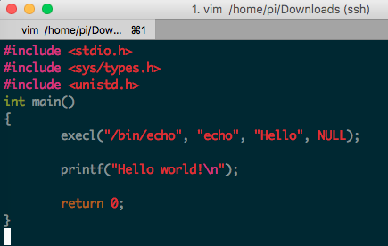
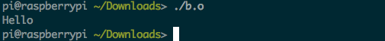
Exec() system call
Replaces current process image with new program image.
Parent
Parent
Child

Slide 79
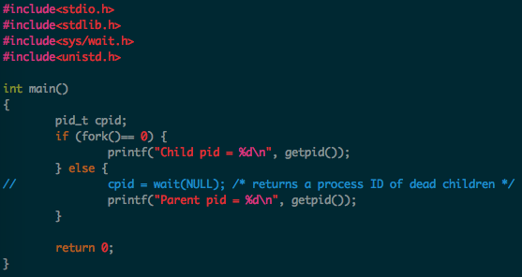
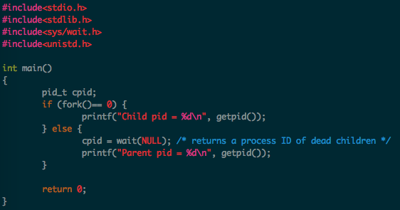
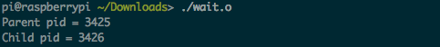
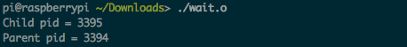
Wait() system call
https://github.com/kevinsuo/CS7172/blob/master/wait.c
Helps the parent process
to know when a child completes
to check the return status of child
Notes:
#include <stdio.h>
#include <sys/types.h>
#include <unistd.h>
int main(void) {
int pid;
pid = fork();
if (pid < 0) {
printf("Fork error!");
} else if (pid == 0) {
printf("The child pid is %d, pid:%d\n", getpid(), pid);
} else {
printf("The parent pid is %d, pid:%d\n", getpid(), pid);
}
return 0;
}

Slide 80
Few other useful syscalls
sleep(seconds)
suspend execution for certain time
exit(status)
Exit the program.
Status is retrieved by the parent using wait().
0 for normal status, non-zero for error
kill(pid_t pid, int sig)
Kill certain process

Slide 81
Outline
What is process?
Process vs Program
Linux Process Control Block
Process related System calls
Fork
Exec
Wait
Process on Distributed OSes

Slide 82
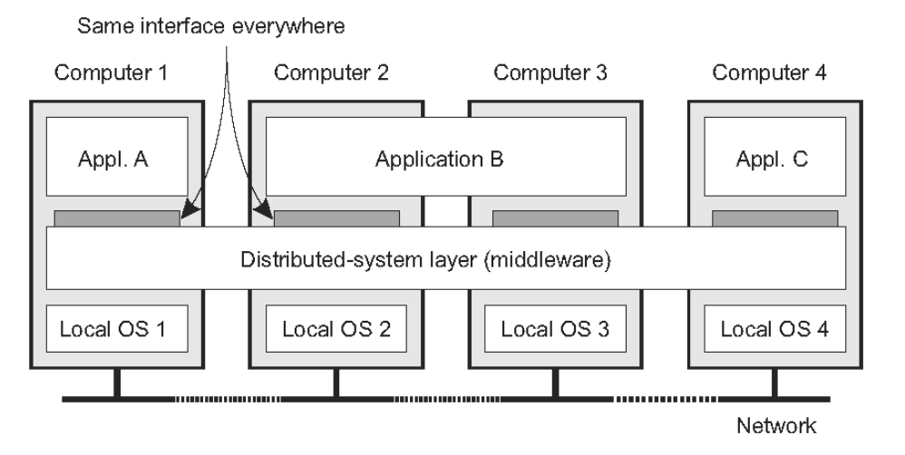
The OS of Distributed Systems
Commonly used components and functions for distributed applications

Slide 83
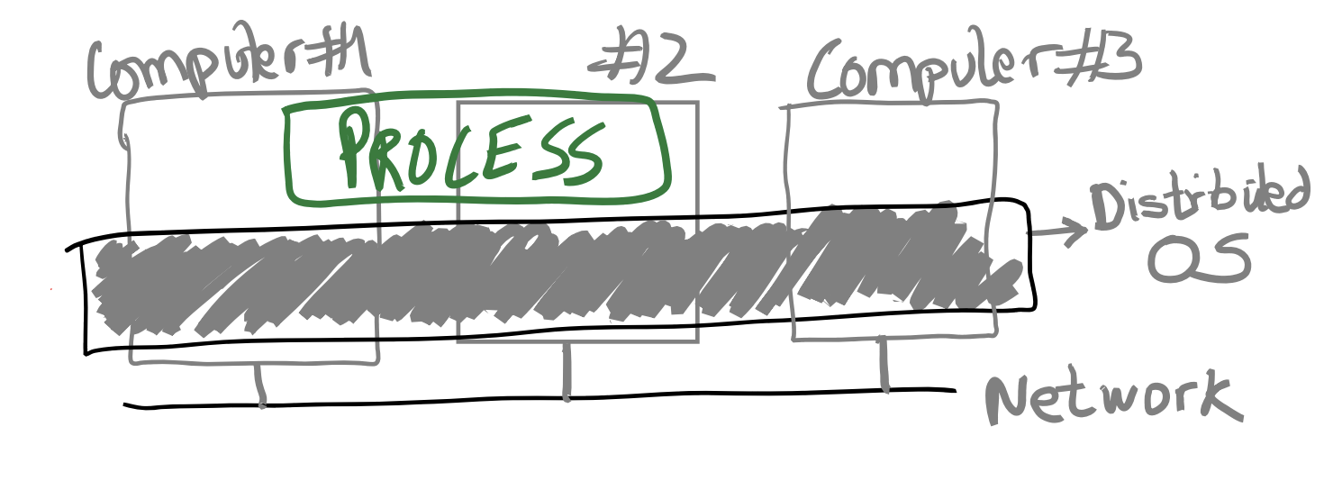
The OS of Distributed Systems
An OS that spans multiple computers
Same OS services, functionality, and abstractions as single-machine OS

Slide 84
Discussion
What could be the challenges for distributed OS?

Slide 85
Distributed OS Challenges
Providing the process abstraction and resource virtualization is hard
Resource virtualization must be transparent
But in distributed settings, there’s always a distinction between local and remote resources
In a single-machine OS, processes don’t care where their resources are coming from:
Which CPU cores, when they are scheduled, which physical memory pages they use, etc.
In fact, providing abstract, virtual resources is one of the main OS services

Slide 86
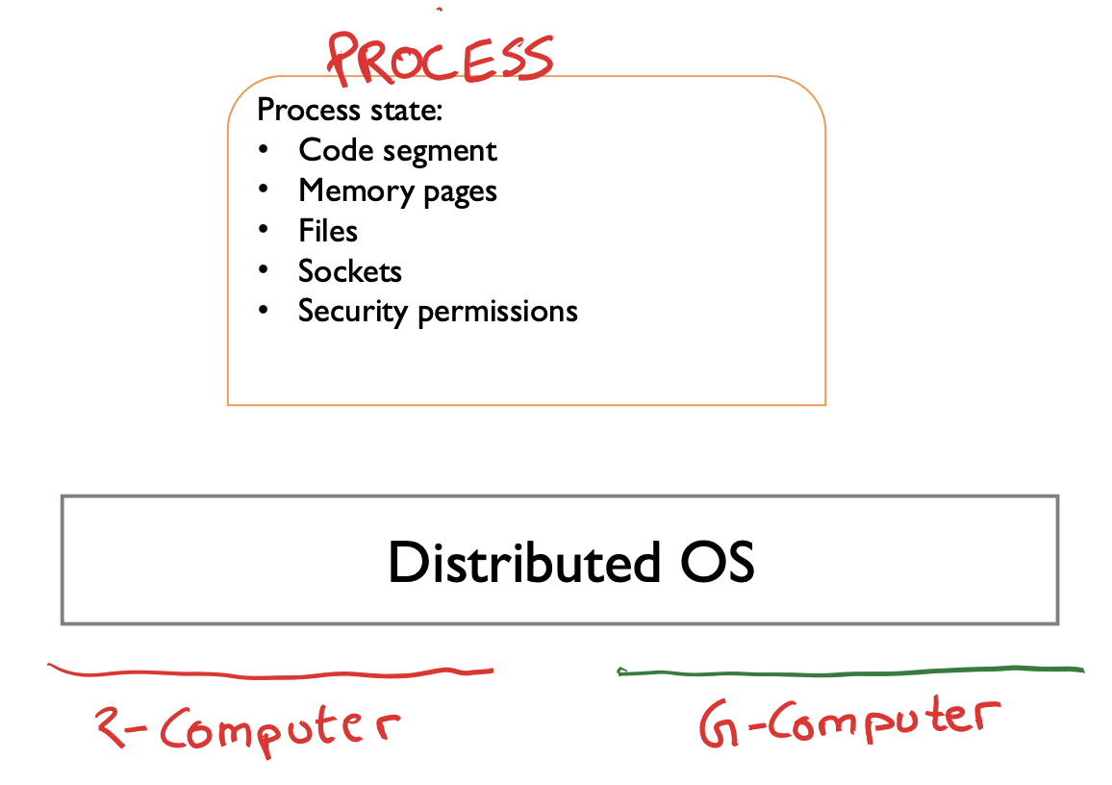
Transparency Issues In Distributed OS
• Where does code run?
• Which memory is used?
Local vs. remote
• How are files accessed?

Slide 87
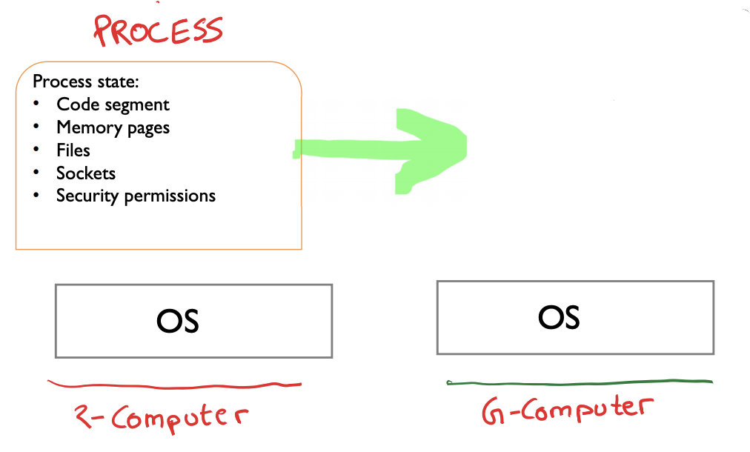
Process Migration
Move all process state from one computer to another
Process state can be vast
Also entangled with other process states
Shared files?
IPC (pipes etc)

Slide 88

Process Migration
Migrate some state? Other state, if required, is accessed over the network?
Example: migrate only fraction of pages. Other pages are copied over the network on access?
Access remote hardware devices (GPUs)?

Slide 89
Conclusion
What is process?
Process vs Program
Linux Process Control Block
Process related System calls
Fork, etc.
Process on Distributed OSes

Slide 90
Context Switch
A context switch is a procedure that a computer's CPU follows to change from one task (or process) to another while ensuring that the tasks do not conflict.

Slide 91
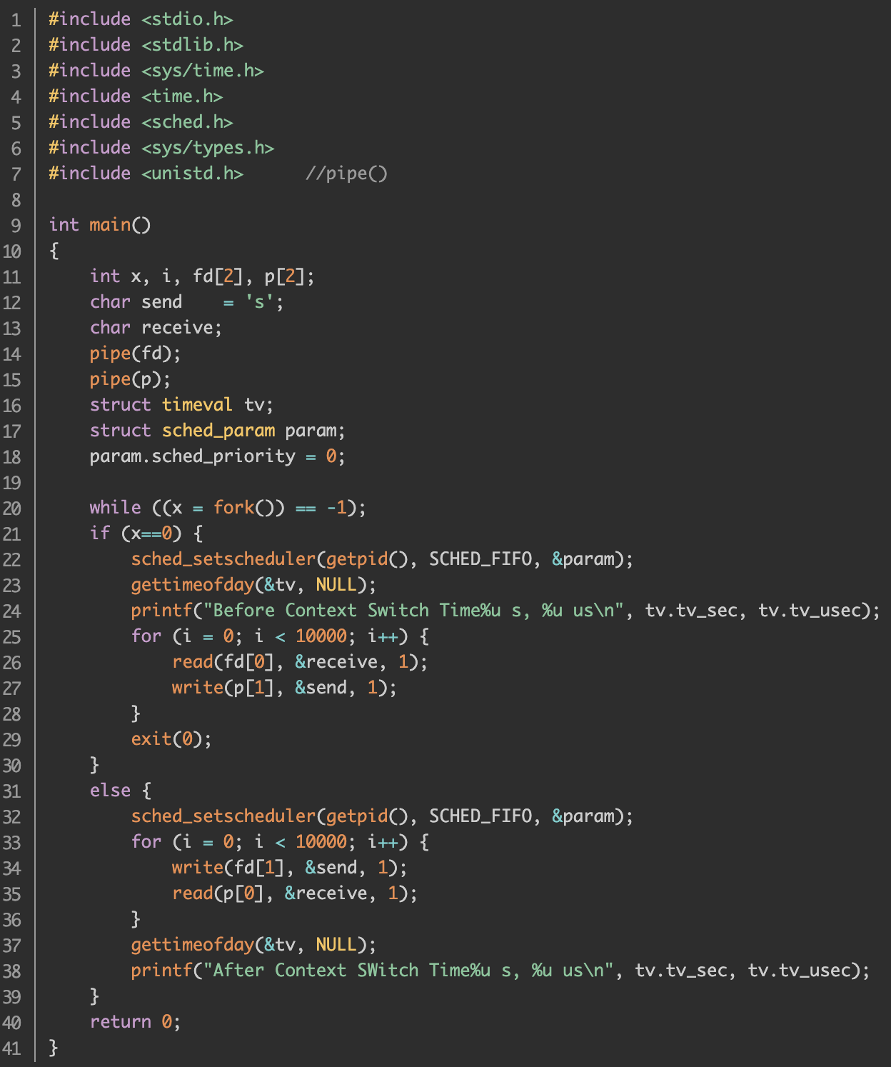
Context Switch
https://github.com/kevinsuo/CS7172/blob/master/cs.c
When A writes pipe, B will be blocked
fd[1]
Write()
Pipe
When B reads pipe, A will be blocked
fd[0]
Read()

Slide 92
Context Switch
fd[1]
Write()
Run 10k times of read and write
Pipe
Run 10k times of read and write
fd[0]
Read()

Slide 93
Context Switch
fd[1]
Write()
Pipe
fd[0]
Read()
10000 times

Slide 94
Context Switch
fd[1]
Write()
Pipe
Context Switch
fd[0]
Read()
10000 times

Slide 95
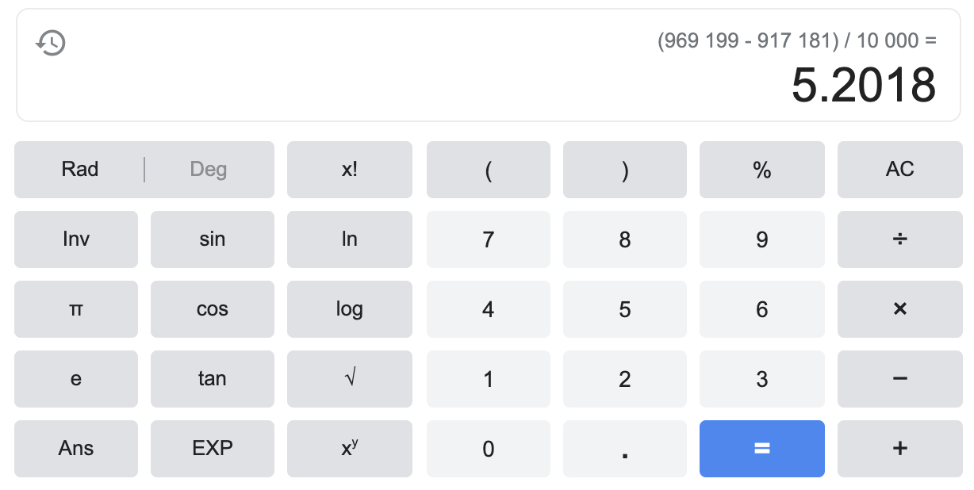
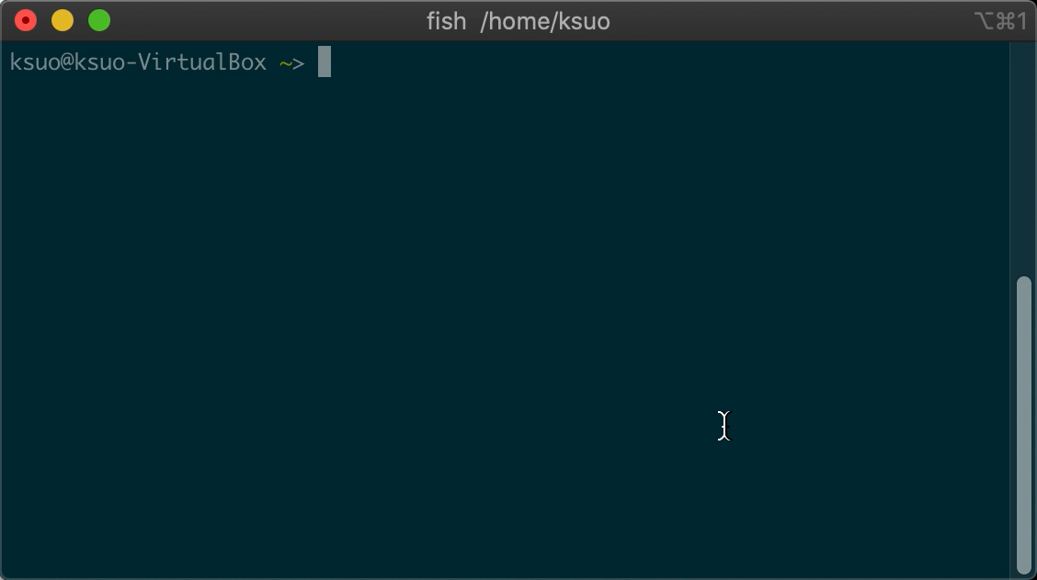
Context Switch

Slide 96
Context Switch
The general system call time consumption is around 200ns
Context switch is 5us >> 200ns

Slide 97
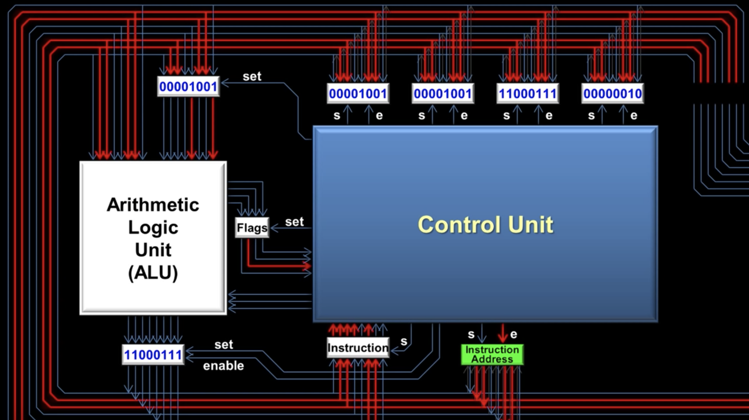
The Cost of Context Switch
Direct cost
Context switch on memory pages
Context switch on kernel heap and stack
Save data into registers, ip(instruction pointer), bp(base pointer), sp(stack poinger)
Flush TLB
Code execution in kernel for scheduling
…

Slide 98
The Cost of Context Switch
Indirect cost
Cache miss
Reload code and data into L1, L2, L3 cache

